Slide 1

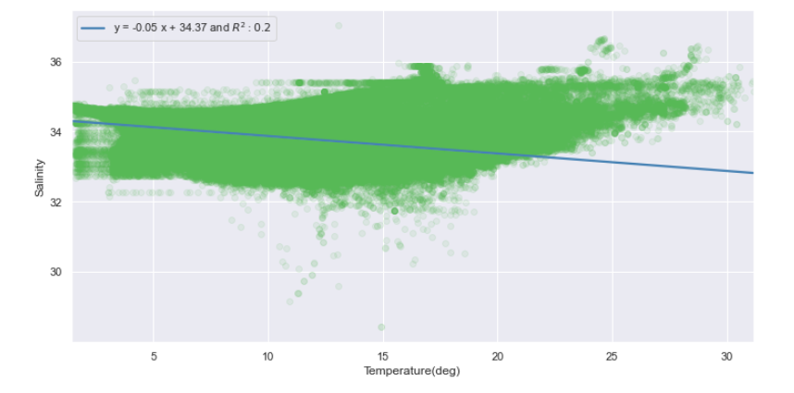
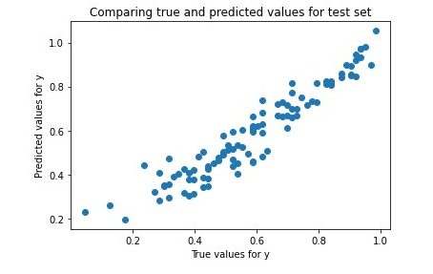
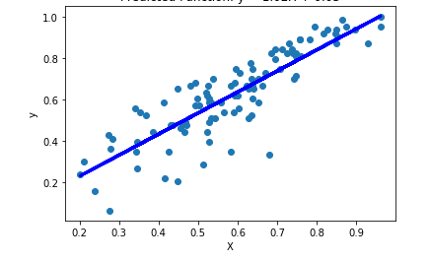
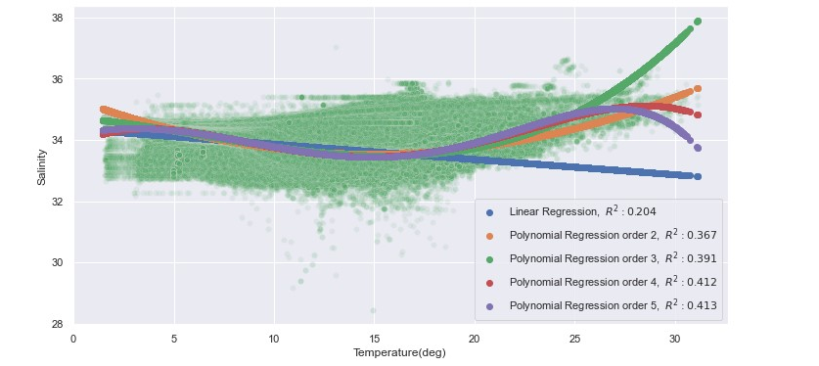
Regression on Water and Sanity Dataset
Linear Regression & Classification Tree (Project 2)
Regression on Admissions Dataset
Once the data was split, we were then able to fit the data to a line and produce a linear regression line alone with the R-Squared value.
Simple Linear Regression
Once we established the relationship between the salinity of water with a single variable, we then observed the polynomial relationship between temperature and the water’s salinity. We can see that they provide a better R-Squared, but they result in a lower fit.
Multiple Linear Regression
Notes:
INTRODUCTION
In this project, we took two datasets and applied both linear and multiple regression models to fit our data. We split our data into two sets in order to train the model and produce predicted values from our test set. This project will be broken on a down into three sections. The first section we will apply linear regression techniques to a water salinity and temperature dataset that is a better dataset for this project. The second section will cover the same linear regression techniques provided dataset for admissions. The final section will cover classification and the analysis of the decision tree.
REGRESSION ON WATER AND SANITY DATASET
We began the linear regression portion of the assignment by splitting the data into the testing and training sets. Once the data was split, we were then able to fit the data to a line and produce a linear regression line along with the R-Squared value.
Once we established the relationship between the salinity of water with a single variable, we then observed the polynomial relationship between temperature and the water’s salinity. We can see that they provide a better R-Squared, but they result in a lower fit.
After we completed the first portion of the assignment, we came to a conclusion that there was a correlation value of .45, which shows that there is a relationship there.
REGRESSION ON ADMISSIONS DATASET
For this part we manually studied the data and made random observations. For example, serial numbers are in ascending order, TOEFL, university rating on a scale of 1-5, SOP, letters of recommendation, and research - either 0 if they have not done research and 1 if they have. For regression we first split the data into training data and test data. The data was split into 80:20 since the distribution of the data in the rows was unknown and we performed shuffling data frames on the data set before partitioning the data into the training data and test data. Then, we applied linear regression and multiple regression on both training and test data, after performing that on both datasets we got some results. Finally, when a simple regression was performed on both training data and the test data it can be seen that the curve that is created is very similar. There are more data points seen in the training data curve due to it being 4x the amount of data points. It's significant that the curves look similar because what can be seen is that with more data points the more accurate the linear regression line is.

Slide 2
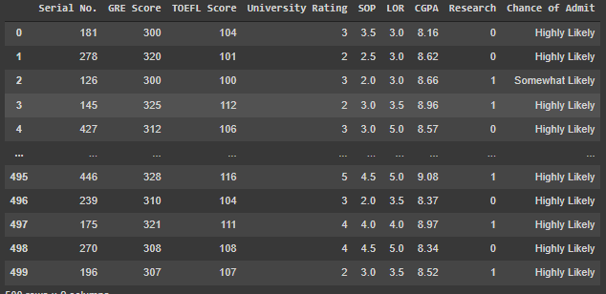
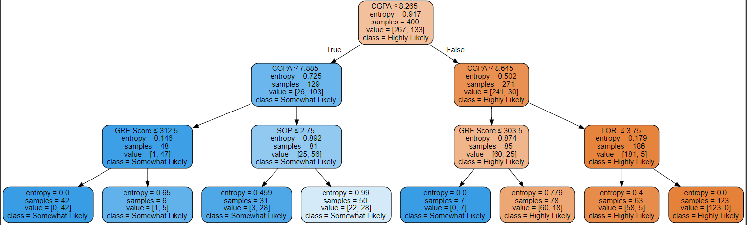
Classification on Admissions Dataset
Possible outputs:
Unlikely
Somewhat unlikely
Highly unlikely
Low: 0-0.33
Mid: 0.34-0.66
High: 0.67-1.00
Notes:
First, we discretize the last column which is “Chance of Admit” into three classes after shuffling. We classify 0-0.33 as low, 0.34-0.66 as mid, and 0.67-1.00 as high.
Then, the data was split 80:20 for training and testing. We dropped the serial number column since it is of no use and since the column we want to predict is chance of admit we set the column to Y and the rest to X. The tree’s criterion is entropy with max depth of 3 and the tree is also displayed with graphviz.
Also, we were able to predict the classes based on our test data from the original dataset. The accuracy on the test data is 82%. This tree has three possible outputs; unlikely, somewhat likely, and highly likely. These outputs are generated based on the inputs from 5 other attributes; Gre scores, toefl score, Cgpa, Lor, and sop.

